Slide 1


Module Project
INFRARED THERMOMETER
WITH SIGNAL CONDITIONING
ADVISORS
DR. LECTURER CELAL ALAGÖZ
DR. LECTURER ŞÜKRÜ ÜNVER
PROF. DR. SABİT HOROZ
DR. LECTURER SEMRA ZEREN
Prepared by Group 4
DİLA KÜBRA DİRİCANLI 230201039
HARUN CAN ELİAÇIK 230201043
RÜMEYSA YÜCEL 230201077

Slide 2

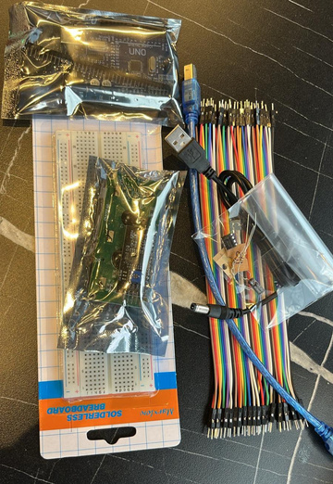
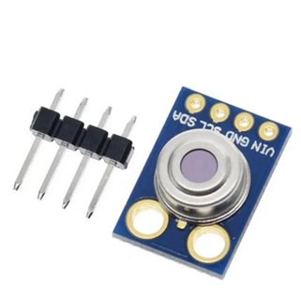
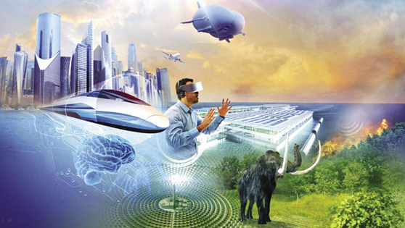

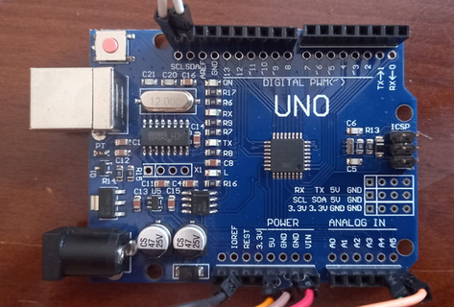

TABLE OF CONTENTS
PURPOSE
MATERIALS
THE STRUCTURE OF THE SENSOR
FUTURE TECHNOLOGIES
USAGE AREAS
ARDUINO PINS
CODE

Slide 3
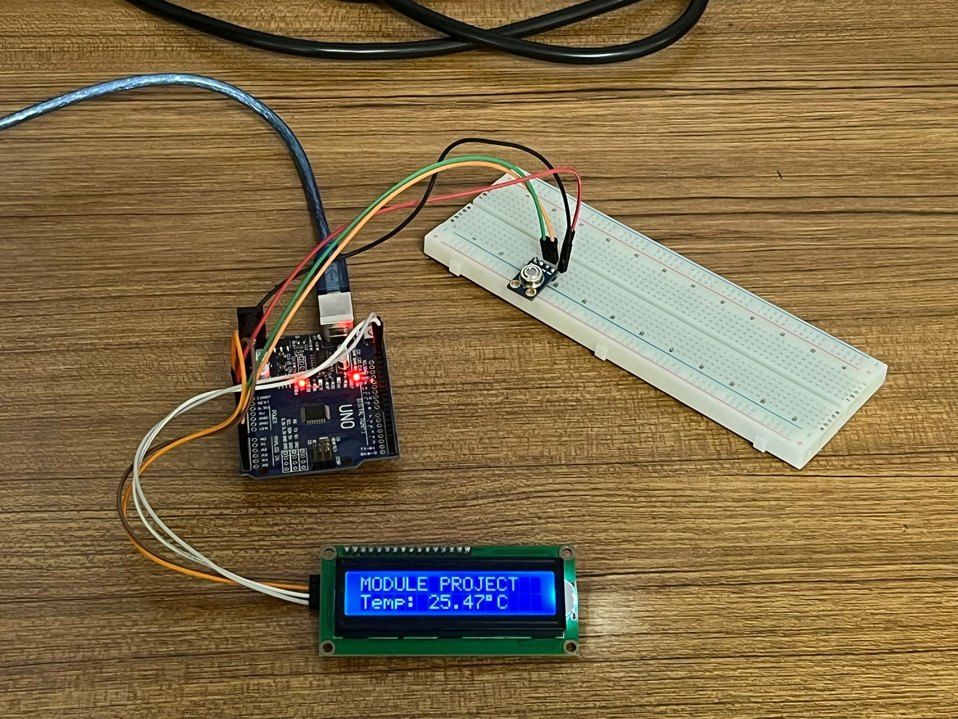
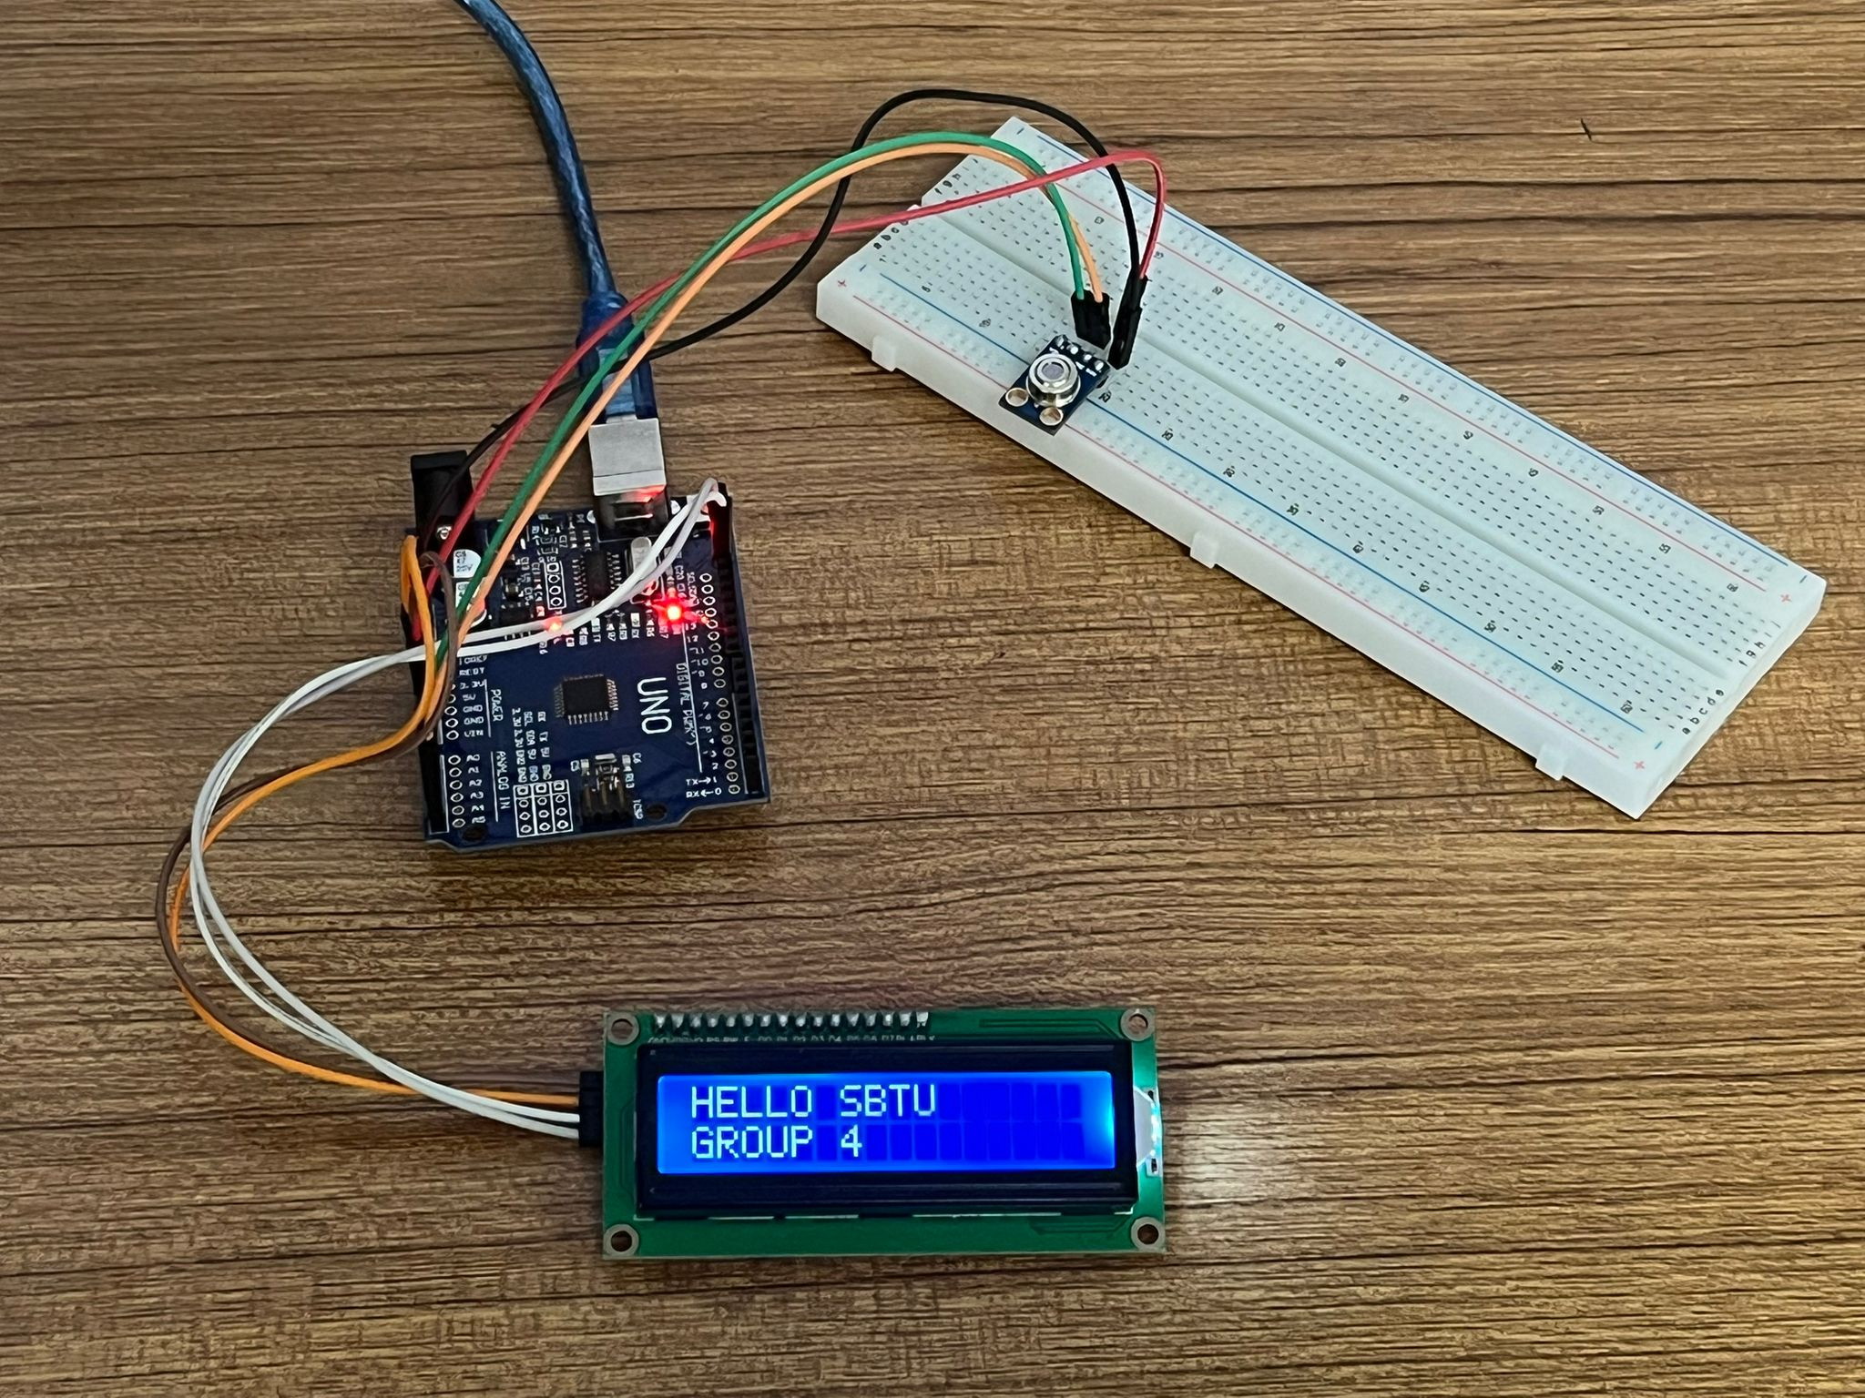
PURPOSE
The signal conditioning infrared thermometer project aims to process and make available the signal coming from the infrared sensor to measure non-contact temperature. This includes determining the temperature range, adapting to different materials, defining the measurement distance and area, and adjusting accuracy and precision. The weak and noisy signal from the sensor is amplified, filtered and corrected if necessary. The effect of ambient temperature is reduced. The measured temperature is displayed on a screen or transferred to other systems. The project also covers power supply, physical design and testing processes.

Slide 4
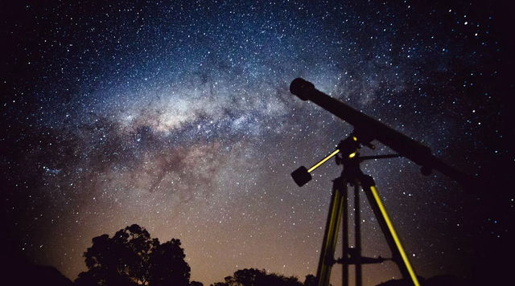
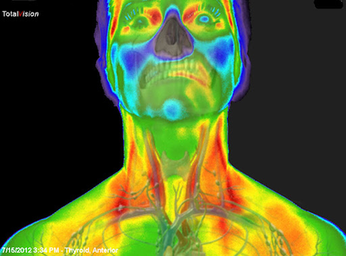
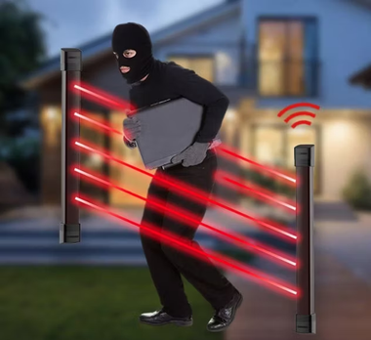
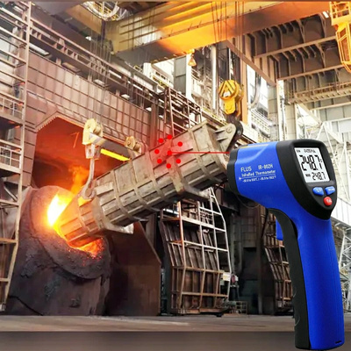
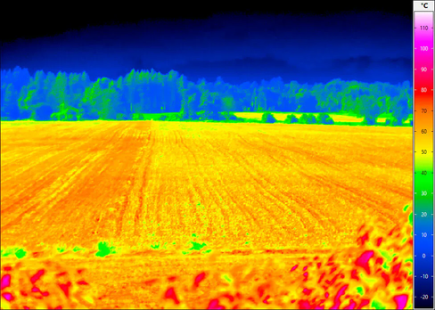
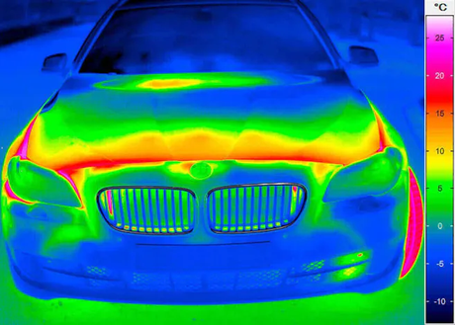
USAGE AREAS
Security
Automotive
Industry
Medicine
Astronomy
Agriculture

Slide 5
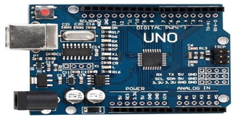
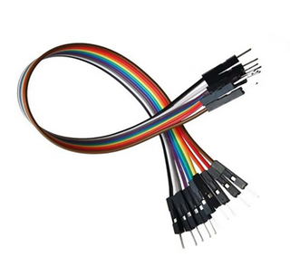
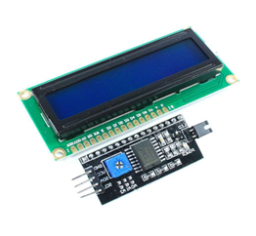
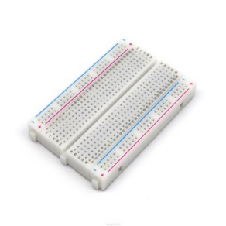
MATERIALS
MLX90614
Infrared Temperature Sensor
Arduino Uno R3
Jumper Wires
16x2LCD Screen
Breadboard

Slide 6

ARDUINO PINS
The pins we use on the Arduino
5V
IOREF
GND
VIN
Analog Pins (A4 and A5)

Slide 7
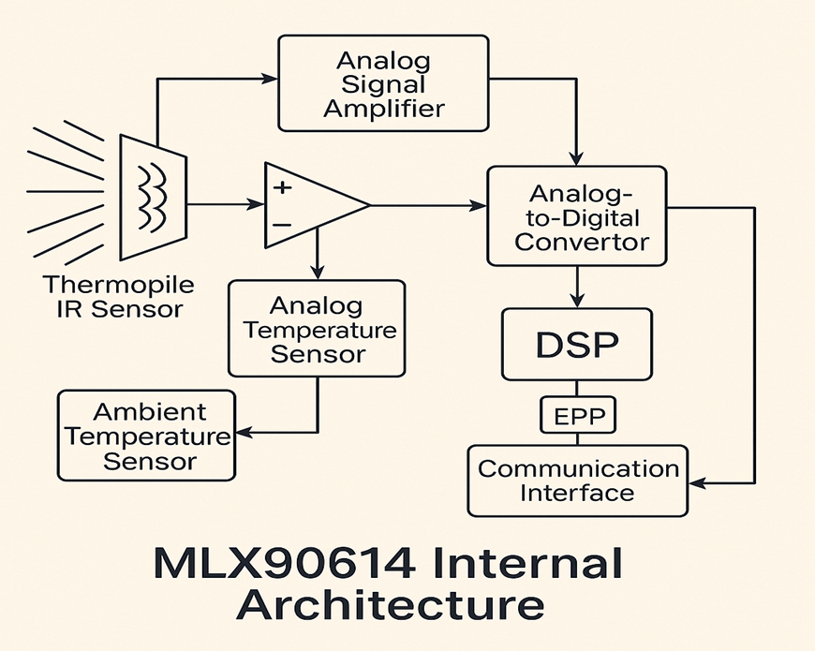
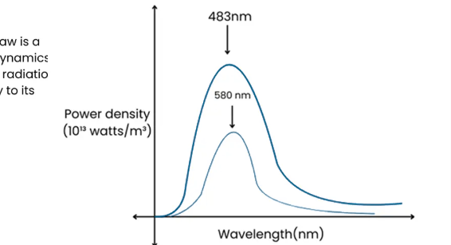
THE STRUCTURE OF THE SENSOR
Stefan-Boltzmann Law
The Stefan-Boltzmann Law is a cornerstone of thermodynamics that relates the thermal radiation emitted by a black body to its temperature.

Slide 8
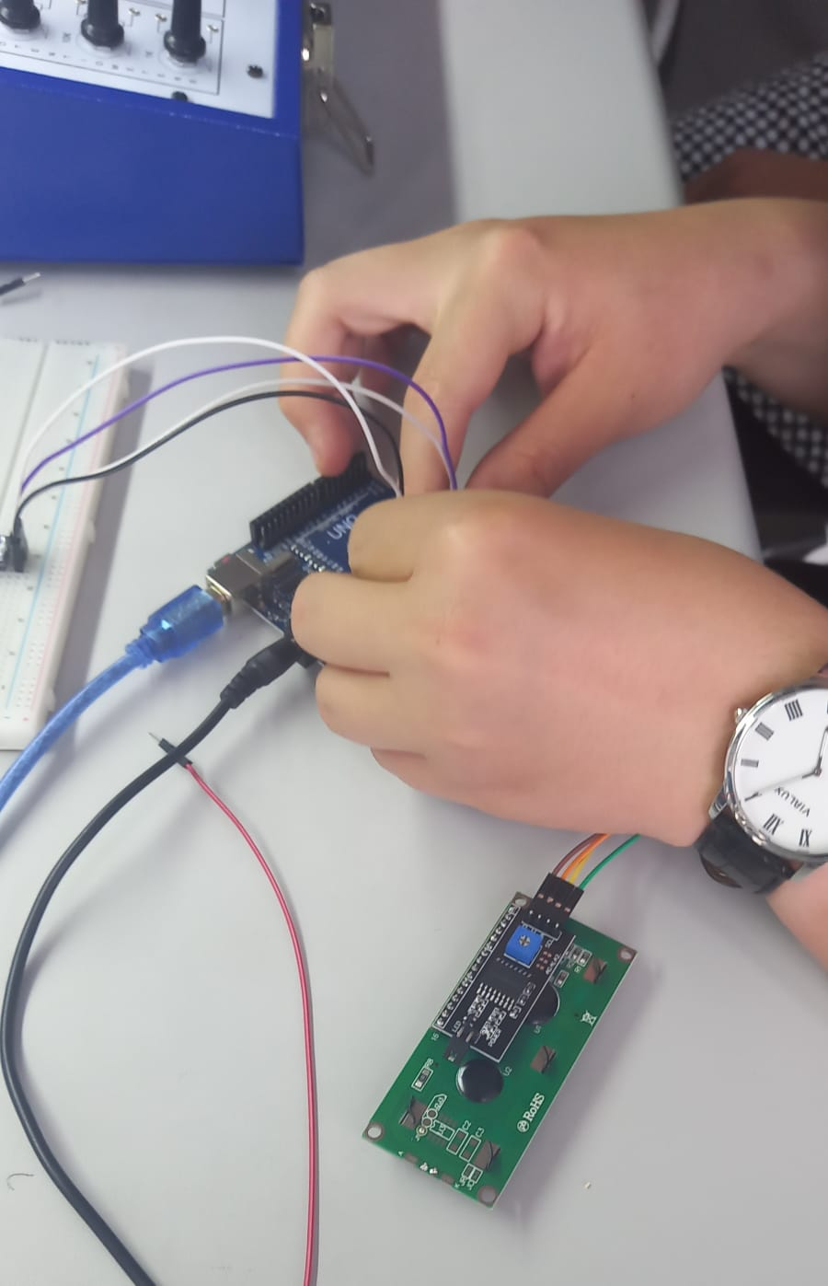
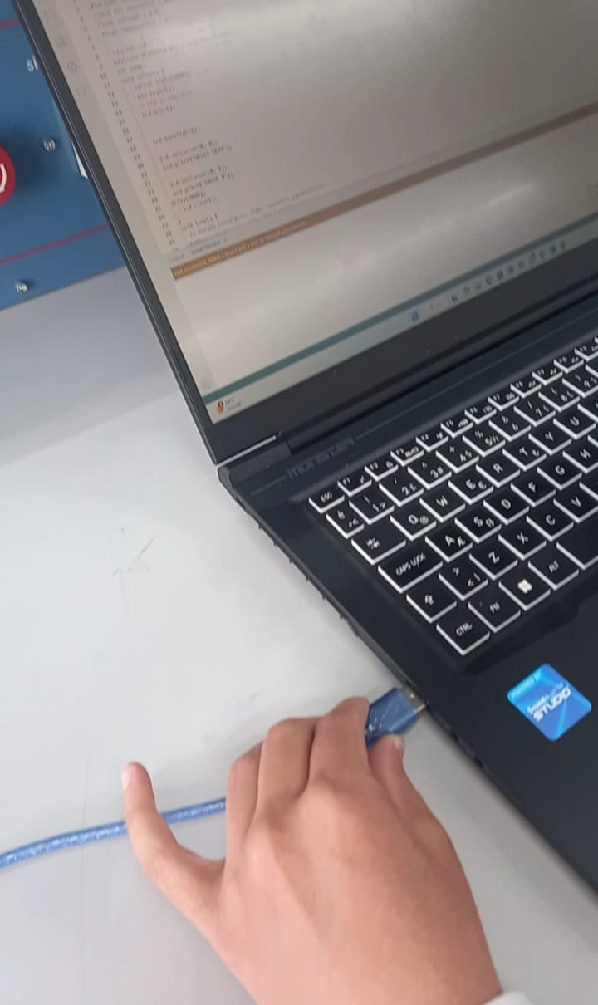
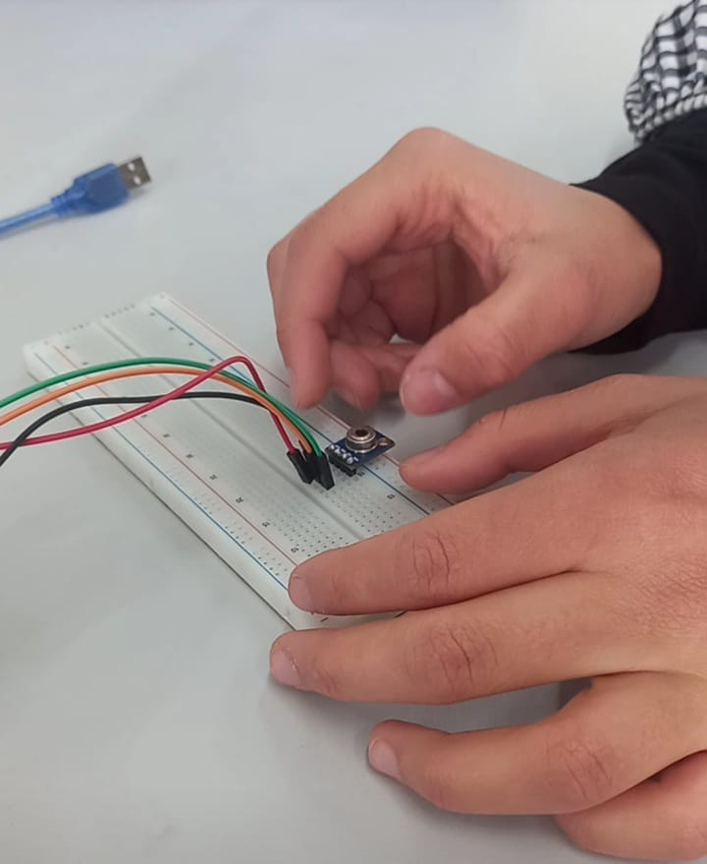
CIRCUIT INSTALLATION
1. LCD Screen Connections (16x2 Character LCD)
2. MLX90614 Infrared Temperature Sensor Connections
3. Power Distribution and Shared Buses

Slide 9
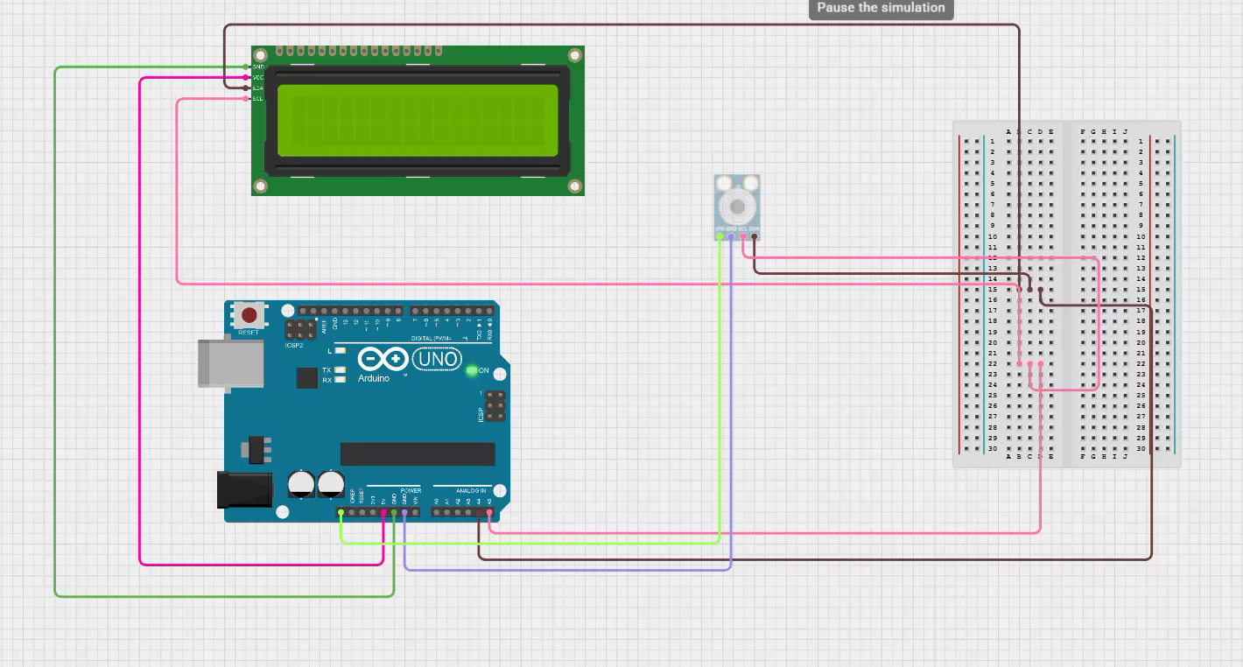
CIRCUIT INSTALLATION

Slide 10

CODE
Libraries (Initial Settings)

Slide 11
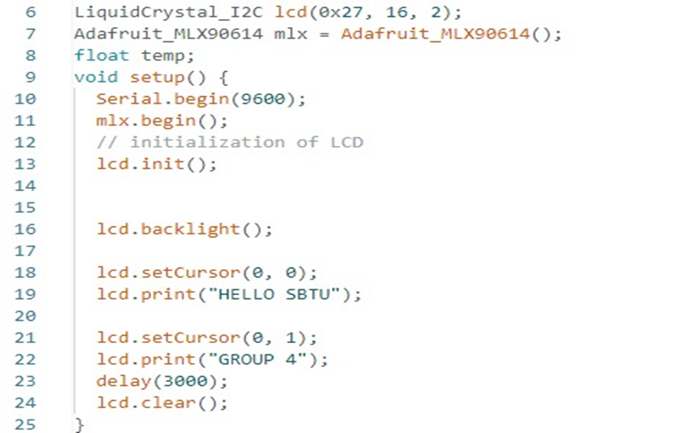
CODE
Object Definitions

Slide 12
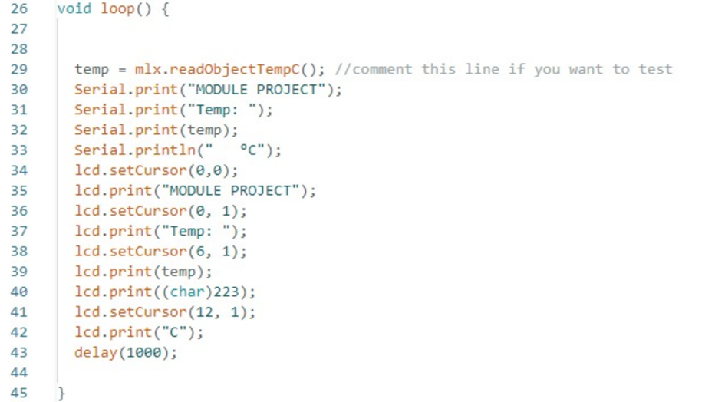
CODE
Function (Continuously Running Loop)

Slide 13
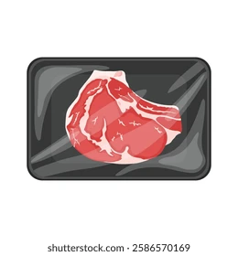
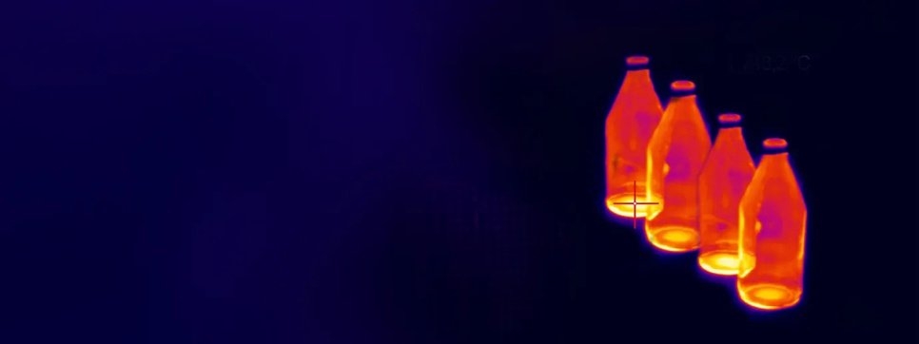


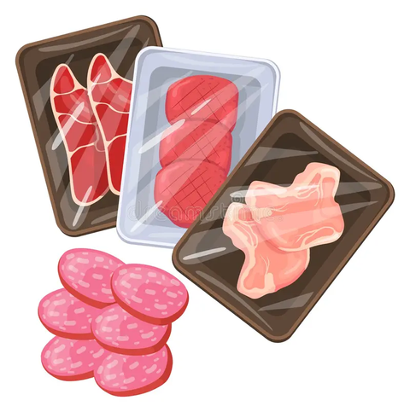


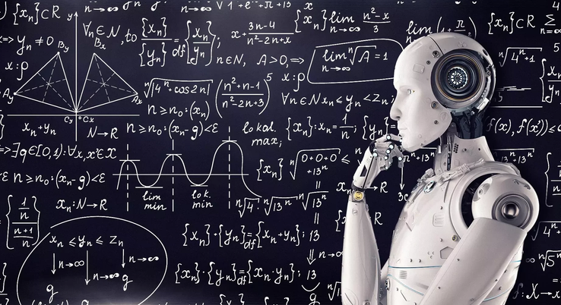
FUTURE TECHNOLOGIES
AI and Machine Learning-Supported Data Processing
Our New Project for Future Technology

Slide 14
Thank you

